Slide 1
Bluffers Guide to Deep Convolutional Neural Networks
Colin Ward

Slide 2
What are we reviewing
Brief History
Subcomponents/Layers and Background
Convolution Layers
Pooling Layers
Fully Connected Layers
ReLU Operations
Training
Back propagation
Gradient Descent
Architectures
Examples

Slide 3
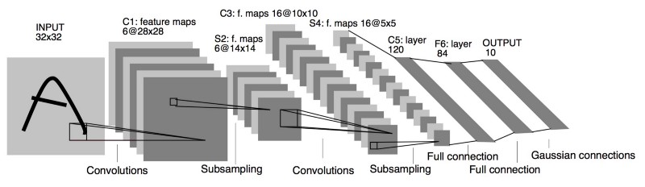
Quick History and Reasoning
Works by Hubel and Wiesel In the 1950’s and 1960’s experiments found monkey’s and cats contain neurons that individually respond to small regions of an image
Neocognitron was developed based on the work of Hubel and Wiesel in 1980 but processing power proved to be a major constraint
LeNet-5 was developed in 1998 to detect hand written signatures with a training set provided by the postal service
AlexNet was the first Neural Network successfully wins the ImageNet competition in 2012 by a huge margin waking the study of neural networks from dormancy
Currently the most accurate network is the Residual Neural Network Architecture
Above is the LeNet-5 Convolutional Neural Network

Slide 4
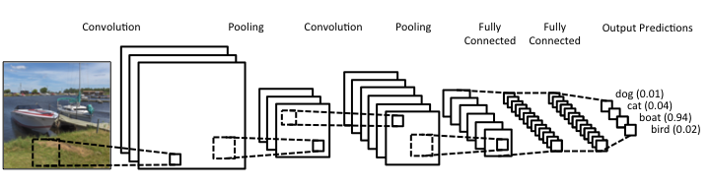
Layer Overview-High Level
Consists of 4 basic building blocks
Pooling Layers
Convolutional Layers
Fully Connected Layers
ReLu/Activation Layers

Slide 5
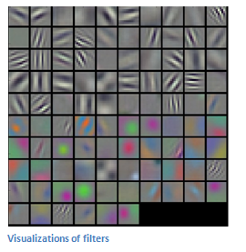


Layer Overview-Convolution Layers
Filters are used to extract features from an image for object recognition
Normally initialized to random numbers or constants
Training and back propagation is used to create these filters
Above are convolutions of different strides

Slide 6
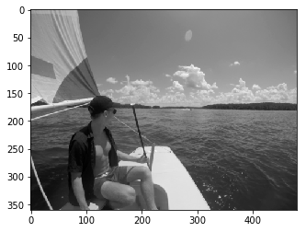
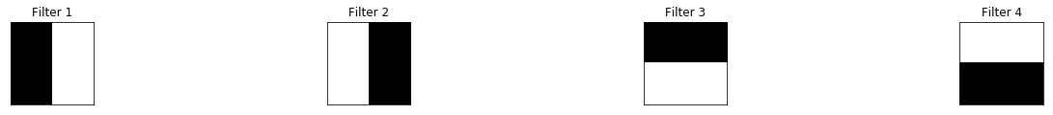
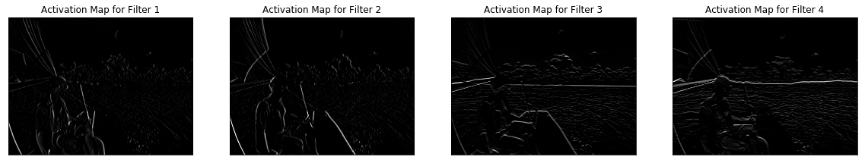
Layer Overview-Convolution Layers

Slide 7
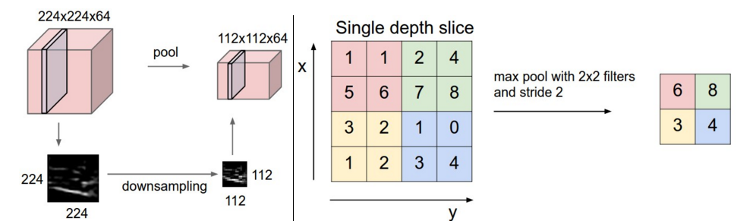
Layer Overview-Pooling Layers
Responsible for down sampling for increased performance
Less spatial information/parameters so reduced chance of over fitting
Translation invariance

Slide 8

Layer Overview-Fully Connected Layers
Apply scores for each class that could potentially be the object there are two common methods
Support Vector Machine (SVM)
Softmax

Slide 9

Layer Overview-Fully Connected Layers
Apply scores for each class that could potentially be the object there are two common methods
Support Vector Machine (SVM)
Softmax

Slide 10
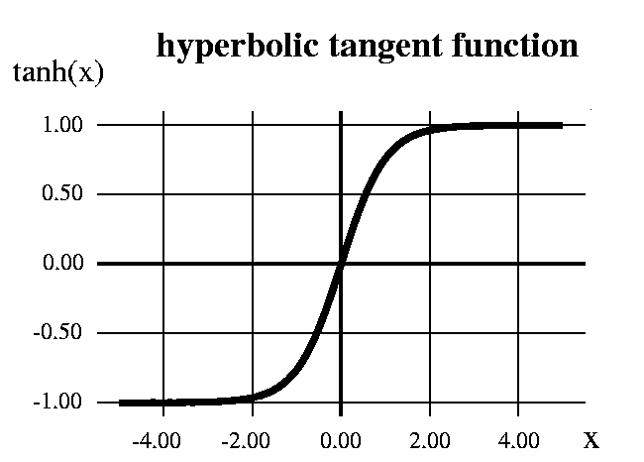
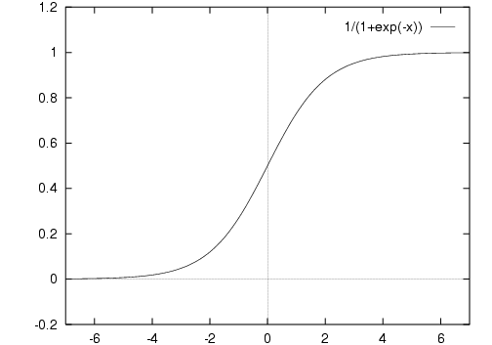
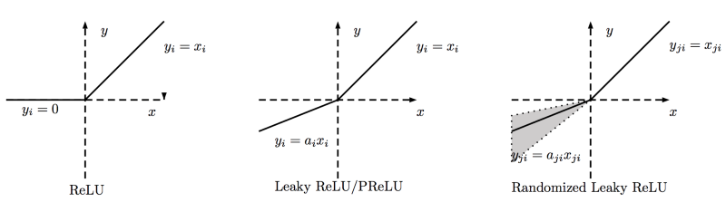
Layer Overview-Activation functions and the Rectified Linear Unit (ReLU)
Make the Neural Network Non-Linear and stop the network from becoming a simple linear regression model
Three Common Activation functions
Sigmoid (f(x) = 1/(1+exp(-x))) – No Longer used
Hyperbolic Tangent function (f(x) = (1 — exp(-2x)) / (1 + exp(-2x))-Used Sometimes
ReLu (f(x)= max(0,x))-Most Common
Notes:
Sigmoids
Vanishing gradient problem
Secondly , its output isn’t zero centered. It makes the gradient updates go too far in different directions. 0 < output < 1, and it makes optimization harder.
Sigmoids saturate and kill gradients.
Sigmoids have slow convergence.
Tanh
Now it’s output is zero centered because its range in between -1 to 1 i.e -1 < output < 1 .
Hence optimization is easier in this method hence in practice it is always preferred over Sigmoid function .
But still it suffers from Vanishing gradient problem
ReLu
It has become very popular in the past couple of years. It was recently proved that it had 6 times improvement in convergencefrom Tanh function. It’s just R(x) = max(0,x) i.e if x < 0 , R(x) = 0 and if x >= 0 , R(x) = x. Hence as seeing the mathematical form of this function we can see that it is very simple and efficient . A lot of times in Machine learning and computer science we notice that most simple and consistent techniques and methods are only preferred and are best. Hence it avoids and rectifies vanishing gradient problem . Almost all deep learning Models use ReLu nowadays.
Typically after a convolution and in hidden layers only

Slide 11

Layer Overview-Activation functions and the Rectified Linear Unit (ReLU)
Make the Neural Network Non-Linear and stop the network from becoming a simple linear regression model
Three Common Activation functions
Sigmoid (f(x) = 1/(1+exp(-x))) – No Longer used
Hyperbolic Tangent function (f(x) = (1 — exp(-2x)) / (1 + exp(-2x))-Used Sometimes
ReLu (f(x)= max(0,x))-Most Common
Notes:
Sigmoids
Vanishing gradient problem
Secondly , its output isn’t zero centered. It makes the gradient updates go too far in different directions. 0 < output < 1, and it makes optimization harder.
Sigmoids saturate and kill gradients.
Sigmoids have slow convergence.
Tanh
Now it’s output is zero centered because its range in between -1 to 1 i.e -1 < output < 1 .
Hence optimization is easier in this method hence in practice it is always preferred over Sigmoid function .
But still it suffers from Vanishing gradient problem
ReLu
It has become very popular in the past couple of years. It was recently proved that it had 6 times improvement in convergencefrom Tanh function. It’s just R(x) = max(0,x) i.e if x < 0 , R(x) = 0 and if x >= 0 , R(x) = x. Hence as seeing the mathematical form of this function we can see that it is very simple and efficient . A lot of times in Machine learning and computer science we notice that most simple and consistent techniques and methods are only preferred and are best. Hence it avoids and rectifies vanishing gradient problem . Almost all deep learning Models use ReLu nowadays.
Typically after a convolution and in hidden layers only

Slide 12
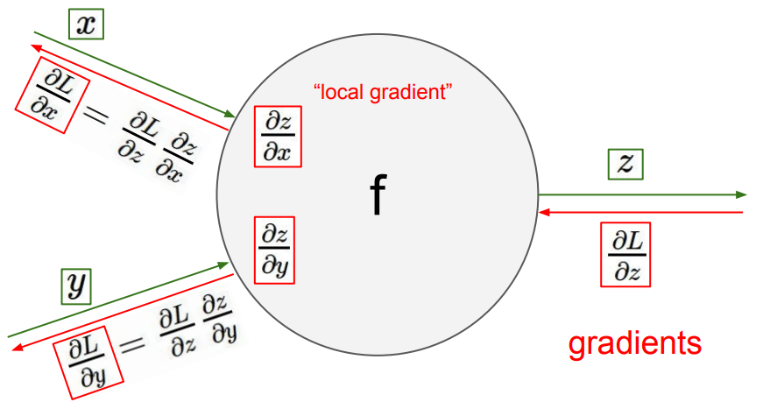
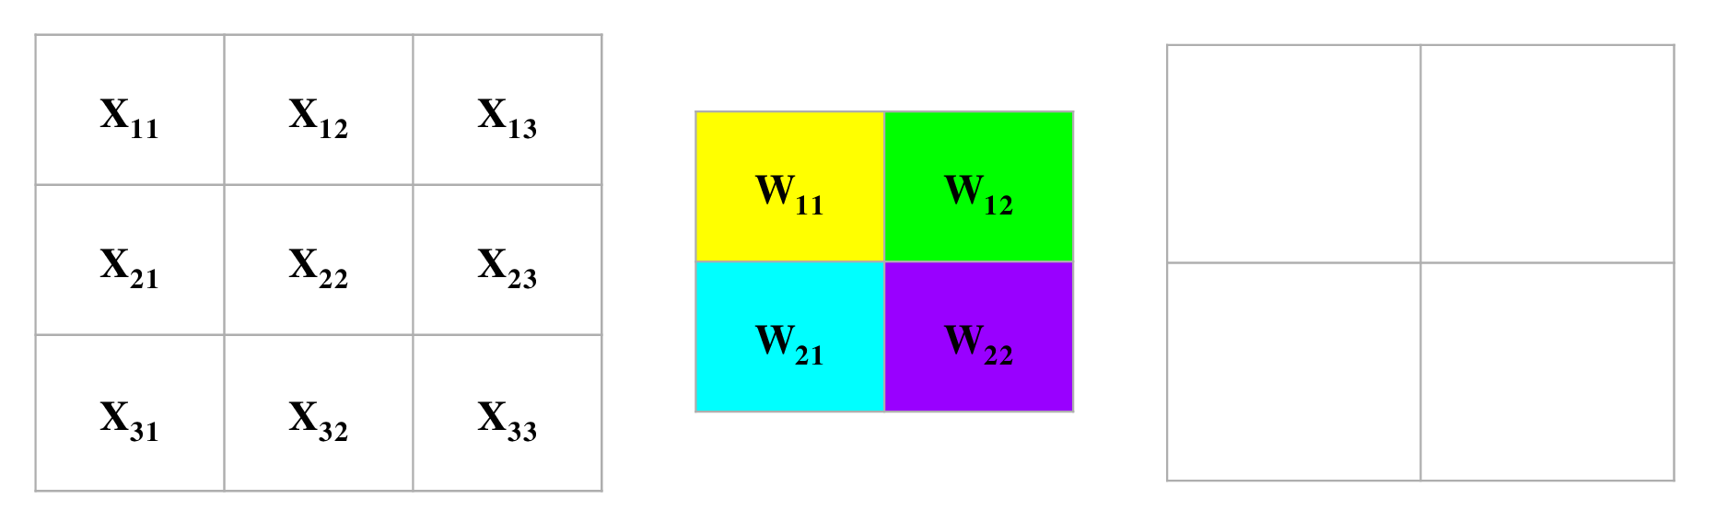
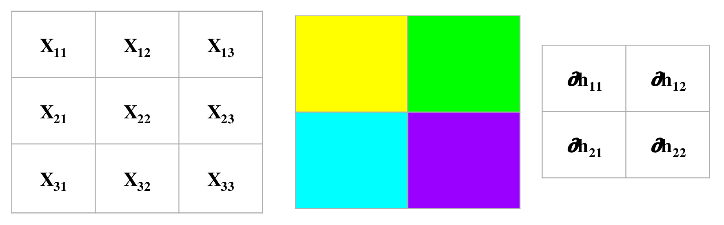
Training-Back Propagation
Notes:
Back propagation
Convolution FW
Convolution Back prop

Slide 13

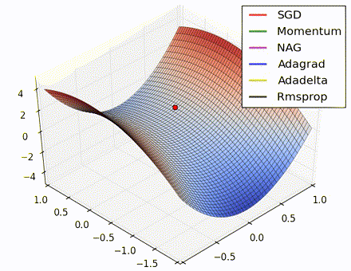
Training-Gradient Descent

Slide 14

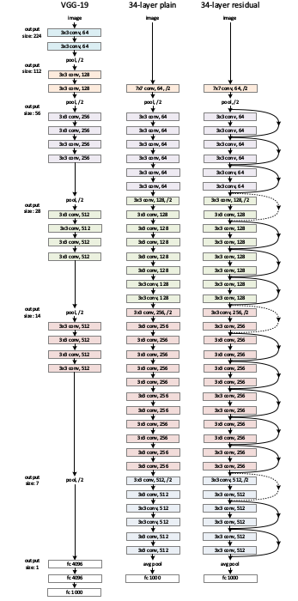
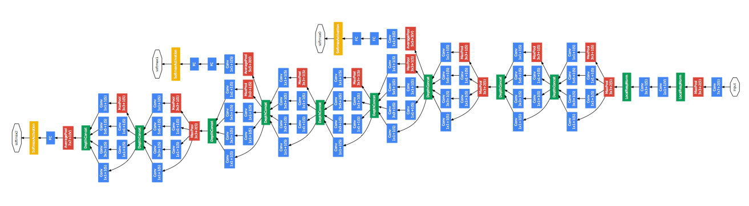
Architectures

Slide 15
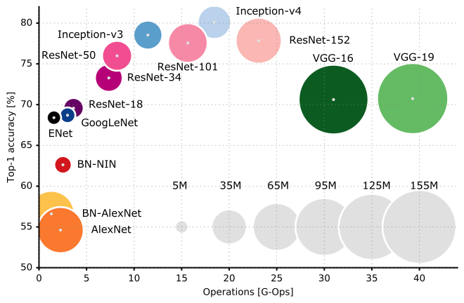
Architectures

Slide 16
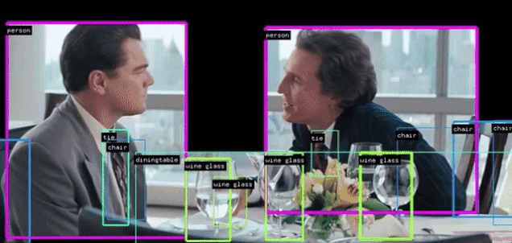
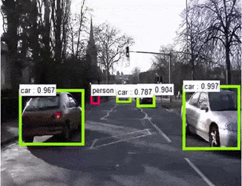
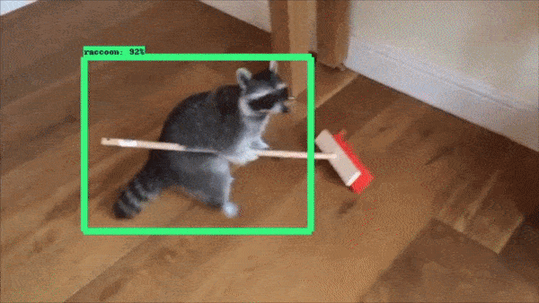
The good stuff

Slide 17
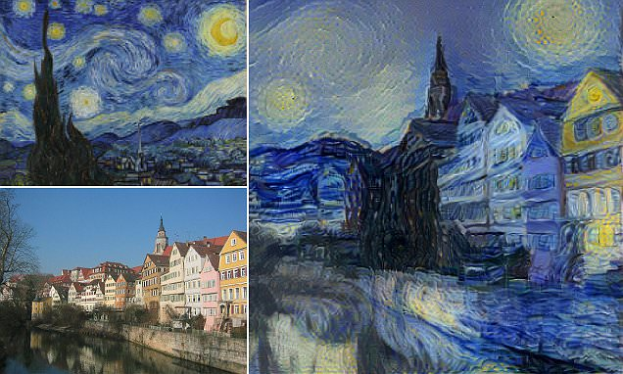
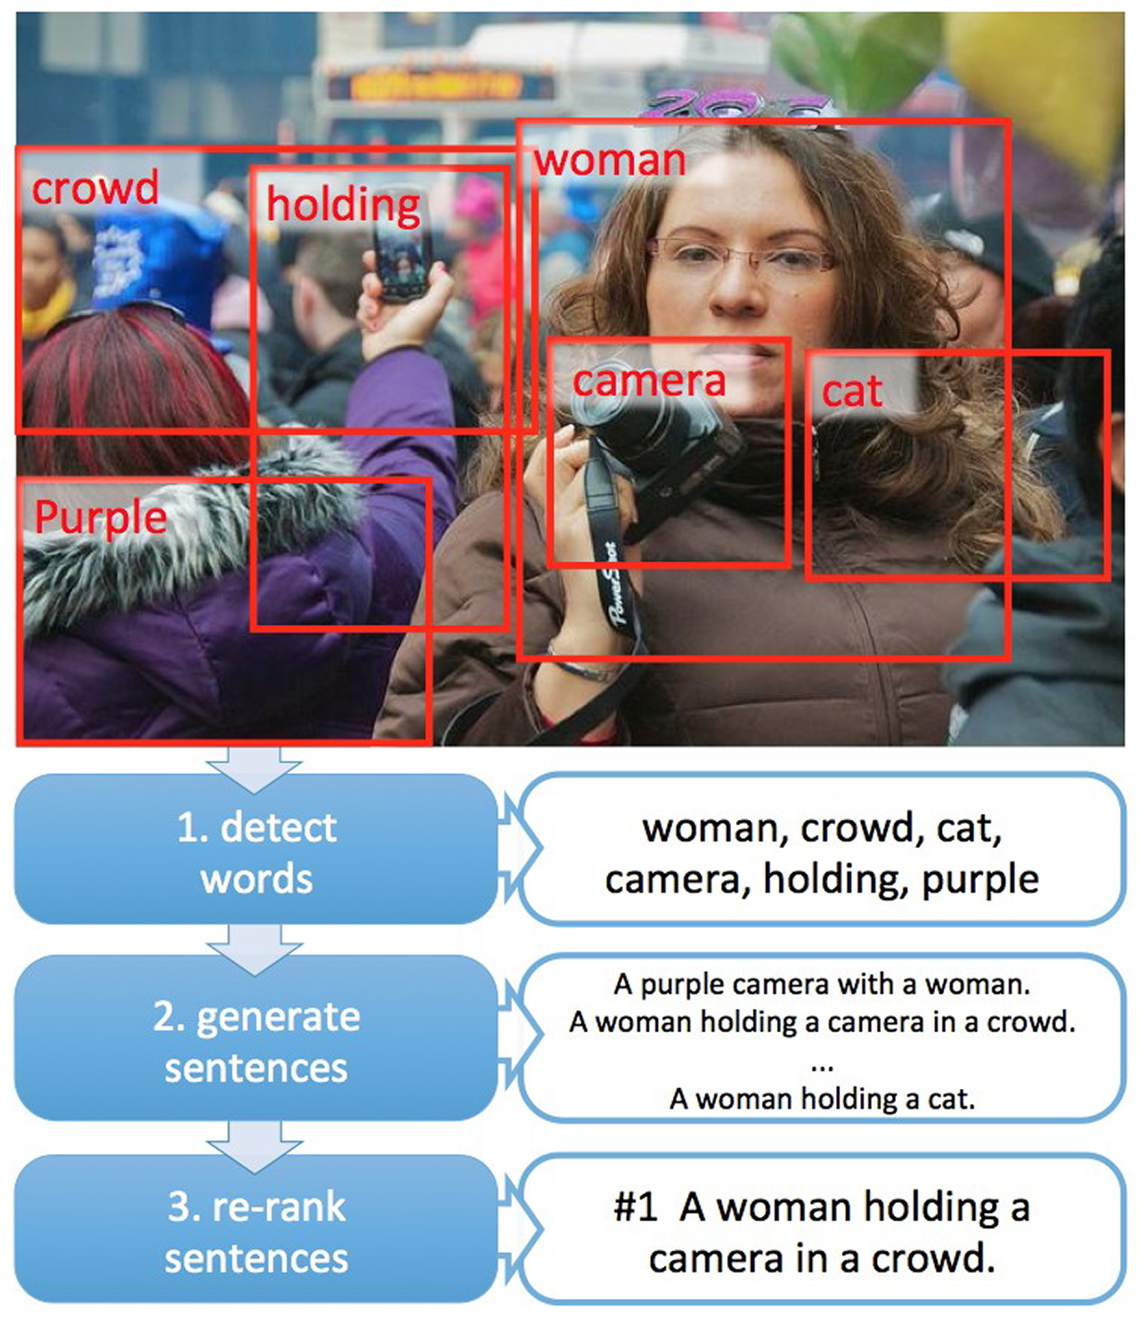
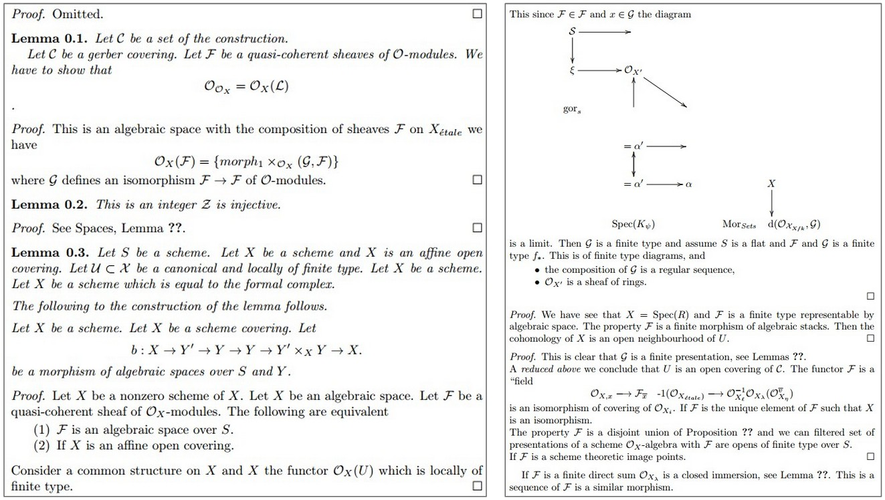
The good stuff cont.

